Slide 1
Lecture 6 Network Security - Technologies
modified from slides of Lawrie Brown
Notes:
A significant security problem for networked systems is hostile, or at least unwanted,
trespass by users or software. User trespass can take the form of unauthorized logon
to a machine or, in the case of an authorized user, acquisition of privileges or performance
of actions beyond those that have been authorized. Software trespass can
take the form of a virus, worm, or Trojan horse.
This chapter covers the subject of intruders. We discuss other forms of attack
in subsequent chapters. First, we examine the nature of the intrusion attack and
then look at strategies detecting intrusions.

Slide 2
Intrusion Detection
Notes:
One of the two most publicized threats to security is the intruder (the other is
malware), generally referred to as a hacker or cracker. In an important early study
of intrusion, Anderson [ANDE80] identified three classes of intruders:
• Masquerader: An individual who is not authorized to use the computer
and who penetrates a system’s access controls to exploit a legitimate user’s
account
• Misfeasor: A legitimate user who accesses data, programs, or resources for
which such access is not authorized, or who is authorized for such access but
misuses his or her privileges
• Clandestine user: An individual who seizes supervisory control of the system
and uses this control to evade auditing and access controls or to suppress audit
collection
The masquerader is likely to be an outsider; the misfeasor generally is an insider;
and the clandestine user can be either an outsider or an insider.
Intruder attacks range from the benign to the serious. At the benign end of the
scale, there are many people who simply wish to explore internets and see what is
out there. At the serious end are individuals who are attempting to read privileged
data, perform unauthorized modifications to data, or disrupt the system.

Slide 3
Hackers
motivated by thrill of access and/or status
hacking community is a strong meritocracy
status is determined by level of competence
benign intruders consume resources and slow performance for legitimate users
intrusion detection systems (IDSs) and intrusion prevention systems (IPSs) to counter hacker threats
can restrict remote logons to specific IP addresses
can use virtual private network technology (VPN)
intruder problem led to establishment of Computer Emergency Response Teams (CERTs)
Notes:
Traditionally, those who hack into computers do so for the thrill of
it or for status. The hacking community is a strong meritocracy in which status
is determined by level of competence. Thus, attackers often look for targets of
opportunity and then share the information with others. A typical example is a
break-in at a large financial institution reported in [RADC04]. The intruder took
advantage of the fact that the corporate network was running unprotected services,
some of which were not even needed. In this case, the key to the break-in was the
pcAnywhere application. The manufacturer, Symantec, advertises this program as
a remote control solution that enables secure connection to remote devices. But the
attacker had an easy time gaining access to pcAnywhere; the administrator used the
same three-letter username and password for the program. In this case, there was
no intrusion detection system on the 700-node corporate network. The intruder was
only discovered when a vice president walked into her office and saw the cursor
moving files around on her Windows workstation.
Benign intruders might be tolerable, although they do consume resources and
may slow performance for legitimate users. However, there is no way in advance to
know whether an intruder will be benign or malign. Consequently, even for systems
with no particularly sensitive resources, there is a motivation to control this problem.
Intrusion detection systems (IDSs) and intrusion prevention systems (IPSs),
of the type described in this chapter and Chapter 9 , respectively, are designed to
counter this type of hacker threat. In addition to using such systems, organizations
can consider restricting remote logons to specific IP addresses and/or use virtual
private network technology.
One of the results of the growing awareness of the intruder problem has been
the establishment of a number of computer emergency response teams (CERTs).
These cooperative ventures collect information about system vulnerabilities and disseminate
it to systems managers. Hackers also routinely read CERT reports. Thus,
it is important for system administrators to quickly install all software patches to
discovered vulnerabilities. Unfortunately, given the complexity of many IT systems,
and the rate at which patches are released, this is increasingly difficult to achieve
without automated updating. Even then, there are problems caused by incompatibilities
resulting from the updated software. Hence the need for multiple layers of
defense in managing security threats to IT systems.

Slide 4
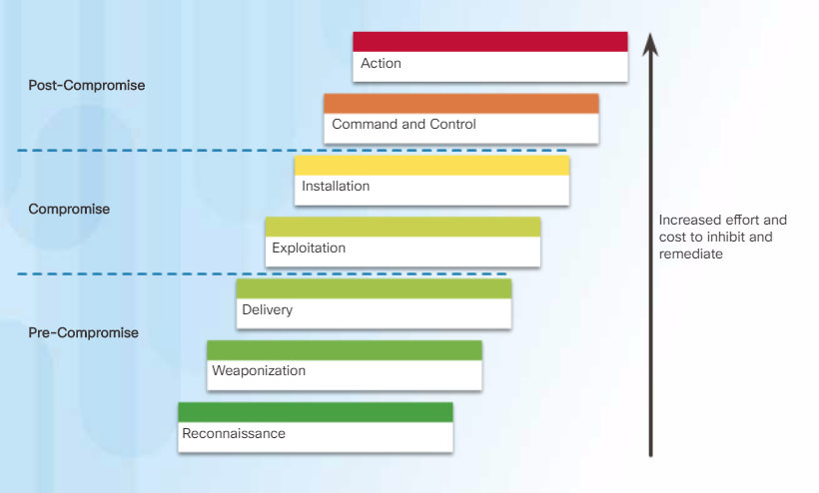
Hacker Kill Chain
Notes:
Table 8.1(a)
Hacker Patterns of Behavior
Hacker Kill Chain: the Hacker Kill Chain is comprised of the following stages:
Stage 1. Reconnaissance - The attacker gathers information about the target.
Stage 2. Weaponization - The attacker creates an exploit and malicious payload to send to the target.
Stage 3. Delivery - The attacker sends the exploit and malicious payload to the target by email or other method.
Stage 4. Exploitation - The exploit is executed.
Stage 5 Installation - Malware and backdoors are installed on the target.
Stage 6. Command and Control - Remote control of the target is gained through a command and control channel or server.
Stage 7. Action - The attacker performs malicious actions like information theft, or executes additional attacks on other devices from within the network by working through the Kill Chain stages again.

Slide 5
Criminals
organized groups of hackers now a threat
corporation / government / loosely affiliated gangs
typically young
meet in underground forums
common target is credit card files on e-commerce servers
criminal hackers usually have specific targets
once penetrated act quickly and get out
IDS / IPS can be used but less effective
sensitive data should be encrypted
Notes:
Organized groups of hackers have become a widespread and common
threat to Internet-based systems. These groups can be in the employ of a corporation
or government but often are loosely affiliated gangs of hackers. Typically, these
gangs are young, often Eastern European, Russian, or southeast Asian hackers who
do business on the Web [ANTE06]. They meet in underground forums with names
like DarkMarket.org and theftservices.com to trade tips and data and coordinate
attacks. A common target is a credit card file at an e-commerce server. Attackers
attempt to gain root access. The card numbers are used by organized crime gangs
to purchase expensive items and are then posted to carder sites, where others can
access and use the account numbers; this obscures usage patterns and complicates
investigation.
Whereas traditional hackers look for targets of opportunity, criminal hackers
usually have specific targets, or at least classes of targets in mind. Once a site is
penetrated, the attacker acts quickly, scooping up as much valuable information as
possible and exiting.
IDSs and IPSs can also be used for these types of attackers but may be less
effective because of the quick in-and-out nature of the attack. For e-commerce sites,
database encryption should be used for sensitive customer information, especially
credit cards. For hosted e-commerce sites (provided by an outsider service), the
e-commerce organization should make use of a dedicated server (not used to support
multiple customers) and closely monitor the provider’s security services.

Slide 6
Insider Attacks
among most difficult to detect and prevent
employees have access and systems knowledge
may be motivated by revenge/entitlement
employment was terminated
taking customer data when moving to a competitor
IDS / IPS can be useful but also need
enforcement of least privilege, monitor logs, strong authentication, termination process
Notes:
Insider attacks are among the most difficult to detect and
prevent. Employees already have access and knowledge about the structure and
content of corporate databases. Insider attacks can be motivated by revenge of
simply a feeling of entitlement. An example of the former is the case of Kenneth
Patterson, fired from his position as data communications manager for American
Eagle Outfitters. Patterson disabled the company’s ability to process credit
card purchases during five days of the holiday season of 2002. As for a sense of
entitlement, there have always been many employees who felt entitled to take
extra office supplies for home use, but this now extends to corporate data. An
example is that of a vice president of sales for a stock analysis firm who quit to go
to a competitor. Before she left, she copied the customer database to take with her.
The offender reported feeling no animus toward her former employee; she simply
wanted the data because it would be useful to her.
Although IDS and IPS facilities can be useful in countering insider attacks, other
more direct approaches are of higher priority. Examples include the following:
• Enforce least privilege, only allowing access to the resources employees need
to do their job.
• Set logs to see what users access and what commands they are entering.
• Protect sensitive resources with strong authentication.
• Upon termination, delete employee’s computer and network access.
• Upon termination, make a mirror image of employee’s hard drive before
reissuing it. That evidence might be needed if your company information turns
up at a competitor.

Slide 7
RFC 2828: Internet Security Glossary
Security Intrusion: A security event, or a combination of multiple security events, that constitutes a security incident in which an intruder gains, or attempts to gain, access to a system (or system resource) without having authorization to do so.
Intrusion Detection : A security service that monitors and analyzes system events for the purpose of finding, and providing real-time or near real-time warning of, attempts to access system resources in an unauthorized manner.
Notes:
The objective of the intruder is to gain access to a system or to increase the range
of privileges accessible on a system. Most initial attacks use system or software
vulnerabilities that allow a user to execute code that opens a back door into the
system. Intruders can get access to a system by exploiting attacks such as buffer
overflows on a program that runs with certain privileges. We examine such software
vulnerabilities in Part Two.
Alternatively, the intruder attempts to acquire information that should have
been protected. In some cases, this information is in the form of a user password.
With knowledge of some other user’s password, an intruder can log in to a system
and exercise all the privileges accorded to the legitimate user. Password guessing
and password acquisition techniques are discussed in Chapter 3 .
The following definitions from RFC 2828 (Internet Security Glossary) are relevant
to our discussion:
Security Intrusion: A security event, or a combination of multiple security
events, that constitutes a security incident in which an intruder gains, or attempts
to gain, access to a system (or system resource) without having authorization
to do so.
Intrusion Detection : A security service that monitors and analyzes
system events for the purpose of finding, and providing real-time or near
real-time warning of, attempts to access system resources in an unauthorized
manner.

Slide 8
Intrusion Detection Systems (IDSs)
host-based IDS
monitors the characteristics of a single host for suspicious activity
network-based IDS
monitors network traffic and analyzes network, transport, and application protocols to identify suspicious activity
comprises three logical components:
sensors - collect data
analyzers - determine if intrusion has occurred
user interface - view output or control system behavior
Notes:
IDSs can be classified as follows:
• Host-based IDS : Monitors the characteristics of a single host and the events
occurring within that host for suspicious activity
• Network-based IDS : Monitors network traffic for particular network segments
or devices and analyzes network, transport, and application protocols
to identify suspicious activity
An IDS comprises three logical components:
• Sensors: Sensors are responsible for collecting data. The input for a sensor
may be any part of a system that could contain evidence of an intrusion. Types
of input to a sensor includes network packets, log files, and system call traces.
Sensors collect and forward this information to the analyzer.
• Analyzers: Analyzers receive input from one or more sensors or from other
analyzers. The analyzer is responsible for determining if an intrusion has
occurred. The output of this component is an indication that an intrusion has
occurred. The output may include evidence supporting the conclusion that an
intrusion occurred. The analyzer may provide guidance about what actions to
take as a result of the intrusion.
• User interface: The user interface to an IDS enables a user to view output
from the system or control the behavior of the system. In some systems, the
user interface may equate to a manager, director, or console component.

Slide 9
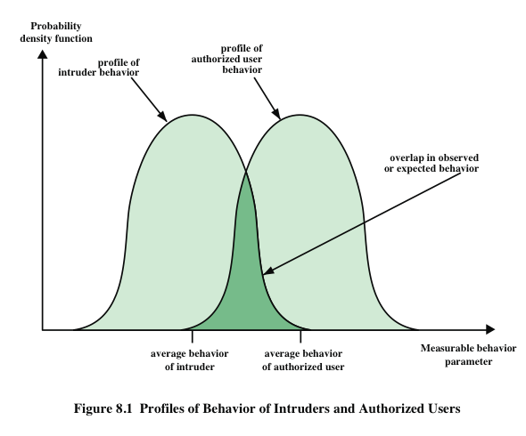
IDS Principles
assume intruder behavior differs from legitimate users
overlap in behaviors causes problems
false positives
false negatives
Notes:
Authentication facilities, access control facilities, and firewalls all play a role in
countering intrusions. Another line of defense is intrusion detection, and this has
been the focus of much research in recent years. This interest is motivated by a
number of considerations, including the following:
1. If an intrusion is detected quickly enough, the intruder can be identified and
ejected from the system before any damage is done or any data are compromised.
Even if the detection is not sufficiently timely to preempt the intruder,
the sooner that the intrusion is detected, the less the amount of damage and
the more quickly that recovery can be achieved.
2. An effective IDS can serve as a deterrent, thus acting to prevent intrusions.
3. Intrusion detection enables the collection of information about intrusion techniques
that can be used to strengthen intrusion prevention measures.
Intrusion detection is based on the assumption that the behavior of the intruder
differs from that of a legitimate user in ways that can be quantified. Of course, we
cannot expect that there will be a crisp, exact distinction between an attack by an
intruder and the normal use of resources by an authorized user. Rather, we must
expect that there will be some overlap.
Figure 8.1 suggests, in abstract terms, the nature of the task confronting the
designer of an IDS. Although the typical behavior of an intruder differs from the
typical behavior of an authorized user, there is an overlap in these behaviors. Thus,
a loose interpretation of intruder behavior, which will catch more intruders, will
also lead to a number of false positives , or authorized users identified as intruders.
On the other hand, an attempt to limit false positives by a tight interpretation of
intruder behavior will lead to an increase in false negatives , or intruders not identified
as intruders. Thus, there is an element of compromise and art in the practice of
intrusion detection.
In Anderson’s study [ANDE80], it was postulated that one could, with reasonable
confidence, distinguish between a masquerader and a legitimate user. Patterns
of legitimate user behavior can be established by observing past history, and significant
deviation from such patterns can be detected. Anderson suggests that the task
of detecting a misfeasor (legitimate user performing in an unauthorized fashion) is
more difficult, in that the distinction between abnormal and normal behavior may
be small. Anderson concluded that such violations would be undetectable solely
through the search for anomalous behavior. However, misfeasor behavior might
nevertheless be detectable by intelligent definition of the class of conditions that
suggest unauthorized use. Finally, the detection of the clandestine user was felt to
be beyond the scope of purely automated techniques. These observations, which
were made in 1980, remain true today.

Slide 10
Host-Based IDS
adds a specialized layer of security software to vulnerable or sensitive systems
monitors activity to detect suspicious behavior
primary purpose is to detect intrusions, log suspicious events, and send alerts
can detect both external and internal intrusions
Notes:
Host-based IDSs add a specialized layer of security software to vulnerable or
sensitive systems; examples include database servers and administrative systems.
The host-based IDS monitors activity on the system in a variety of ways to detect
suspicious behavior. In some cases, an IDS can halt an attack before any damage
is done, but its primary purpose is to detect intrusions, log suspicious events, and
send alerts.
The primary benefit of a host-based IDS is that it can detect both external and
internal intrusions, something that is not possible either with network-based IDSs
or firewalls.

Slide 11
Host-Based IDS Approaches to Intrusion Detection
anomaly detection
Collecting behavior of users and analyze them
signature detection
involves an attempt to define a set of rules or attack patterns that can be used to decide that a given behavior is that of an intruder
threshold detection
involves counting the number of occurrences of a specific event type over an interval of time
profile based
profile of the activity of each user is developed and used to detect changes in the behavior of individual accounts
Notes:
Host-based IDSs follow one of two general approaches to intrusion detection:
1. Anomaly detection : Involves the collection of data relating to the behavior
of legitimate users over a period of time. Then statistical tests are applied to
observed behavior to determine with a high level of confidence whether that
behavior is not legitimate user behavior. The following are two approaches to
statistical anomaly detection:
a. Threshold detection: This approach involves defining thresholds, independent
of user, for the frequency of occurrence of various events.
b. Profile based: A profile of the activity of each user is developed and used
to detect changes in the behavior of individual accounts.
2. Signature detection : Involves an attempt to define a set of rules or attack patterns
that can be used to decide that a given behavior is that of an intruder.
In essence, anomaly approaches attempt to define normal, or expected, behavior,
whereas signature-based approaches attempt to define proper behavior.
In terms of the types of attackers listed earlier, anomaly detection is effective
against masqueraders, who are unlikely to mimic the behavior patterns of the
accounts they appropriate. On the other hand, such techniques may be unable to
deal with misfeasors. For such attacks, signature-based approaches may be able
to recognize events and sequences that, in context, reveal penetration. In practice,
a system may employ a combination of both approaches to be effective against a
broad range of attacks.

Slide 12
Host-Based IDS: Audit Records
native audit records
multiuser operating systems include accounting software that collects information on user activity
advantage is that no additional collection software is needed
disadvantage is that records may not contain the needed information or in a convenient form
detection-specific audit record
collection facility that generates records containing only information required by the IDS
advantage is that it could be made vendor independent and ported to a variety of systems
disadvantage is the extra overhead of having, in effect, two accounting packages running on a machine
Notes:
A fundamental tool for intrusion detection is the audit record. 1 Some record of
ongoing activity by users must be maintained as input to an IDS. Basically, two
plans are used:
• Native audit records: Virtually all multiuser operating systems include
accounting software that collects information on user activity. The advantage
of using this information is that no additional collection software is needed.
The disadvantage is that the native audit records may not contain the needed
information or may not contain it in a convenient form.
• Detection-specific audit records: A collection facility can be implemented that
generates audit records containing only that information required by the IDS.
One advantage of such an approach is that it could be made vendor independent
and ported to a variety of systems. The disadvantage is the extra overhead
involved in having, in effect, two accounting packages running on a machine.

Slide 13
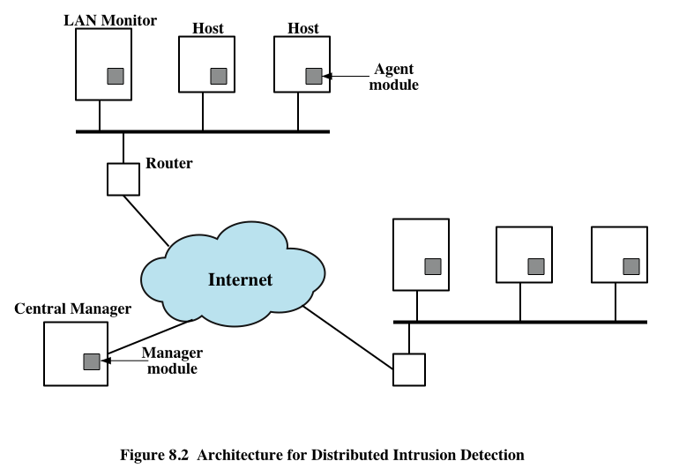
Distributed Host-Based IDS
Notes:
Traditionally, work on host-based IDSs focused on single-system stand-alone facilities.
The typical organization, however, needs to defend a distributed collection
of hosts supported by a LAN or internetwork. Although it is possible to mount a
defense by using stand-alone IDSs on each host, a more effective defense can be
achieved by coordination and cooperation among IDSs across the network.
Porras points out the following major issues in the design of a distributed IDS
[PORR92]:
• A distributed IDS may need to deal with different audit record formats. In a
heterogeneous environment, different systems will employ different native audit
collection systems and, if using intrusion detection, may employ different
formats for security-related audit records.
• One or more nodes in the network will serve as collection and analysis points
for the data from the systems on the network. Thus, either raw audit data or
summary data must be transmitted across the network. Therefore, there is a
requirement to assure the integrity and confidentiality of these data. Integrity
is required to prevent an intruder from masking his or her activities by altering
the transmitted audit information. Confidentiality is required because the
transmitted audit information could be valuable.
• Either a centralized or decentralized architecture can be used. With a centralized
architecture, there is a single central point of collection and analysis of
all audit data. This eases the task of correlating incoming reports but creates
a potential bottleneck and single point of failure. With a decentralized architecture,
there is more than one analysis center, but these must coordinate their
activities and exchange information.
A good example of a distributed IDS is one developed at the University of
California at Davis [HEBE92, SNAP91]; a similar approach has been taken for a
project at Purdue [SPAF00, BALA98]. Figure 8.2 shows the overall architecture,
which consists of three main components:
• Host agent module: An audit collection module operating as a background
process on a monitored system. Its purpose is to collect data on security related
events on the host and transmit these to the central manager.
LAN monitor agent module: Operates in the same fashion as a host agent
module except that it analyzes LAN traffic and reports the results to the central
manager.
• Central manager module: Receives reports from LAN monitor and host
agents and processes and correlates these reports to detect intrusion.

Slide 14
Network-Based IDS (NIDS)
monitors traffic at selected points on a network
examines traffic packet by packet in real or close to real time
may examine network, transport, and/or application-level protocol activity
comprised of a number of sensors, one or more servers for NIDS management functions, and one or more management consoles for the human interface
analysis of traffic patterns may be done at the sensor, the management server or a combination of the two
Notes:
A network-based IDS (NIDS) monitors traffic at selected points on a network or
interconnected set of networks. The NIDS examines the traffic packet by packet in
real time, or close to real time, to attempt to detect intrusion patterns. The NIDS
may examine network-, transport-, and/or application-level protocol activity. Note
the contrast with a host-based IDS; a NIDS examines packet traffic directed toward
potentially vulnerable computer systems on a network. A host-based system examines
user and software activity on a host.
A typical NIDS facility includes a number of sensors to monitor packet traffic, one
or more servers for NIDS management functions, and one or more management consoles
for the human interface. The analysis of traffic patterns to detect intrusions may
be done at the sensor, at the management server, or some combination of the two.

Slide 15
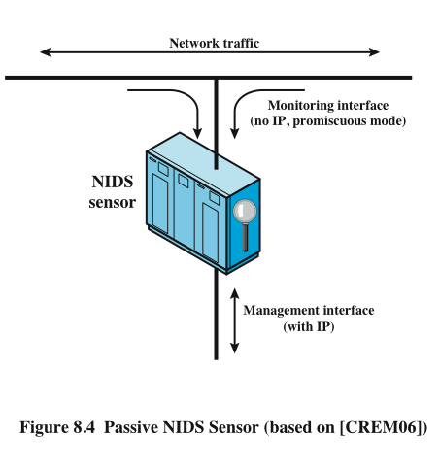
NIDS Sensor Deployment
inline sensor
inserted into a network segment so that the traffic that it is monitoring must pass through the sensor
passive sensors
monitors a copy of network traffic
Notes:
Sensors can be deployed in one of two modes: inline and passive. An inline
sensor is inserted into a network segment so that the traffic that it is monitoring
must pass through the sensor. One way to achieve an inline sensor is to combine
NIDS sensor logic with another network device, such as a firewall or a LAN
switch. This approach has the advantage that no additional separate hardware
devices are needed; all that is required is NIDS sensor software. An alternative
is a stand-alone inline NIDS sensor. The primary motivation for the use of
inline sensors is to enable them to block an attack when one is detected. In this
case the device is performing both intrusion detection and intrusion prevention
functions.
More commonly, passive sensors are used. A passive sensor monitors a
copy of network traffic; the actual traffic does not pass through the device. From
the point of view of traffic flow, the passive sensor is more efficient than the
inline sensor, because it does not add an extra handling step that contributes to
packet delay.
Figure 8.4 illustrates a typical passive sensor configuration. The sensor connects
to the network transmission medium, such as a fiber optic cable, by a direct
physical tap. The tap provides the sensor with a copy of all network traffic being
carried by the medium. The network interface card (NIC) for this tap usually does
not have an IP address configured for it. All traffic into this NIC is simply collected
with no protocol interaction with the network. The sensor has a second NIC that
connects to the network with an IP address and enables the sensor to communicate
with a NIDS management server.

Slide 16
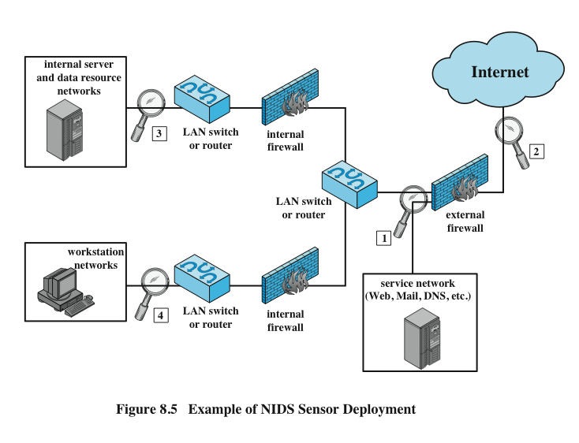
NISD Sensor Deployment Example
Notes:
Consider an organization with multiple sites, each of which has one or more LANs,
with all of the networks interconnected via the Internet or some other WAN
technology. For a comprehensive NIDS strategy, one or more sensors are needed
at each site. Within a single site, a key decision for the security administrator is the
placement of the sensors.
Figure 8.5 illustrates a number of possibilities. In general terms, this configuration
is typical of larger organizations. All Internet traffic passes through an external firewall
that protects the entire facility. 2 Traffic from the outside world, such as customers and
vendors that need access to public services, such as Web and mail, is monitored. The
external firewall also provides a degree of protection for those parts of the network
that should only be accessible by users from other corporate sites. Internal firewalls
may also be used to provide more specific protection to certain parts of the network.
A common location for a NIDS sensor is just inside the external firewall
( location 1 in the figure). This position has a number of advantages:
• Sees attacks, originating from the outside world, that penetrate the network’s
perimeter defenses (external firewall).
• Highlights problems with the network firewall policy or performance.
• Sees attacks that might target the Web server or ftp server.
• Even if the incoming attack is not recognized, the IDS can sometimes recognize
the outgoing traffic that results from the compromised server.
Instead of placing a NIDS sensor inside the external firewall, the security
administrator may choose to place a NIDS sensor between the external firewall and
the Internet or WAN ( location 2 ). In this position, the sensor can monitor all network
traffic, unfiltered. The advantages of this approach are as follows:
• Documents number of attacks originating on the Internet that target the network
• Documents types of attacks originating on the Internet that target the network
A sensor at location 2 has a higher processing burden than any sensor located
elsewhere on the site network.
In addition to a sensor at the boundary of the network, on either side of the
external firewall, the administrator may configure a firewall and one or more sensors
to protect major backbone networks, such as those that support internal servers
and database resources ( location 3 ). The benefits of this placement include the
following:
• Monitors a large amount of a network’s traffic, thus increasing the possibility
of spotting attacks
• Detects unauthorized activity by authorized users within the organization’s
security perimeter
Thus, a sensor at location 3 is able to monitor for both internal and external
attacks. Because the sensor monitors traffic to only a subset of devices at the site, it can
be tuned to specific protocols and attack types, thus reducing the processing burden.
Finally, the network facilities at a site may include separate LANs that support
user workstations and servers specific to a single department. The administrator
could configure a firewall and NIDS sensor to provide additional protection for
all of these networks or target the protection to critical subsystems, such as personnel
and financial networks ( location 4 ). A sensor used in this latter fashion provides
the following benefits:
• Detects attacks targeting critical systems and resources
• Allows focusing of limited resources to the network assets considered of
greatest value
As with a sensor at location 3, a sensor at location 4 can be tuned to specific
protocols and attack types, thus reducing the processing burden.

Slide 17
Honeypot
decoy systems designed to:
lure a potential attacker away from critical systems
collect information about the attacker’s activity
encourage the attacker to stay on the system long enough for administrators to respond
filled with fabricated information that a legitimate user of the system wouldn’t access
resource that has no production value
incoming communication is most likely a probe, scan, or attack
outbound communication suggests that the system has probably been compromised
once hackers are within the network, administrators can observe their behavior to figure out defenses
Notes:
A relatively recent innovation in intrusion detection technology is the honeypot.
Honeypots are decoy systems that are designed to lure a potential attacker away
from critical systems. Honeypots are designed to
• Divert an attacker from accessing critical systems.
• Collect information about the attacker’s activity.
• Encourage the attacker to stay on the system long enough for administrators
to respond.
These systems are filled with fabricated information designed to appear valuable
but that a legitimate user of the system wouldn’t access. Thus, any access to the
honeypot is suspect. The system is instrumented with sensitive monitors and event
loggers that detect these accesses and collect information about the attacker’s activities.
Because any attack against the honeypot is made to seem successful, administrators
have time to mobilize and log and track the attacker without ever exposing
productive systems.
The honeypot is a resource that has no production value. There is no legitimate
reason for anyone outside the network to interact with a honeypot. Thus, any
attempt to communicate with the system is most likely a probe, scan, or attack.
Conversely, if a honeypot initiates outbound communication, the system has probably
been compromised.
Initial efforts involved a single honeypot computer with IP addresses designed
to attract hackers. More recent research has focused on building entire honeypot
networks that emulate an enterprise, possibly with actual or simulated traffic and
data. Once hackers are within the network, administrators can observe their behavior
in detail and figure out defenses.

Slide 18
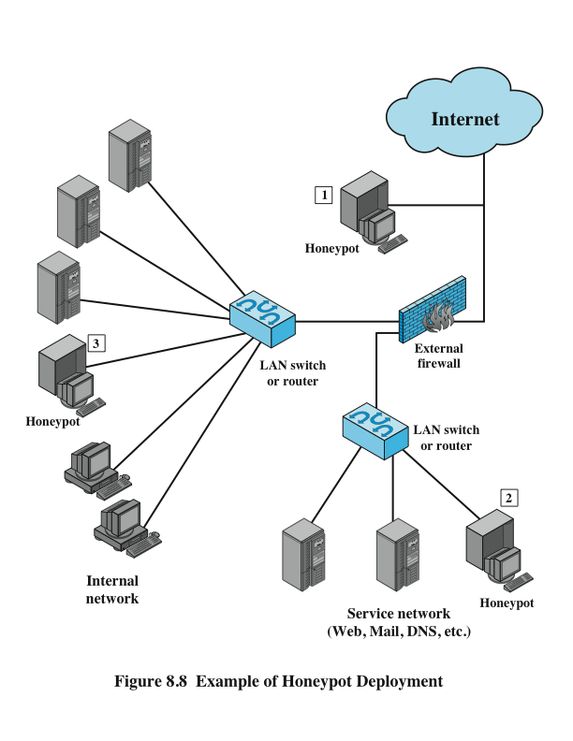
Honeypot Deployment
Notes:
Honeypots can be deployed in a variety of locations. Figure 8.8 illustrates
some possibilities. The location depends on a number of factors, such as the type
of information the organization is interested in gathering and the level of risk that
organizations can tolerate to obtain the maximum amount of data.
A honeypot outside the external firewall ( location 1 ) is useful for tracking
attempts to connect to unused IP addresses within the scope of the network. A honeypot
at this location does not increase the risk for the internal network. The danger
of having a compromised system behind the firewall is avoided. Further, because
the honeypot attracts many potential attacks, it reduces the alerts issued by the firewall
and by internal IDS sensors, easing the management burden. The disadvantage
of an external honeypot is that it has little or no ability to trap internal attackers,
especially if the external firewall filters traffic in both directions.
The network of externally available services, such as Web and mail, often
called the DMZ (demilitarized zone), is another candidate for locating a honeypot
( location 2 ). The security administrator must assure that the other systems in the
DMZ are secure against any activity generated by the honeypot. A disadvantage of
this location is that a typical DMZ is not fully accessible, and the firewall typically
blocks traffic to the DMZ the attempts to access unneeded services. Thus, the firewall
either has to open up the traffic beyond what is permissible, which is risky, or
limit the effectiveness of the honeypot.
A fully internal honeypot ( location 3 ) has several advantages. Its most important
advantage is that it can catch internal attacks. A honeypot at this location can
also detect a misconfigured firewall that forwards impermissible traffic from the
Internet to the internal network. There are several disadvantages. The most serious
of these is if the honeypot is compromised so that it can attack other internal
systems. Any further traffic from the Internet to the attacker is not blocked by the
firewall because it is regarded as traffic to the honeypot only. Another difficulty for
this honeypot location is that, as with location 2, the firewall must adjust its filtering
to allow traffic to the honeypot, thus complicating firewall configuration and potentially
compromising the internal network.

Slide 19
Firewalls
Notes:
Firewalls can be an effective means of protecting a local system or network of
systems from network-based security threats while at the same time affording access
to the outside world via wide area networks and the Internet.
Information systems in corporations, government agencies, and other organizations
have undergone a steady evolution. The following are notable developments:
• Centralized data processing system, with a central mainframe supporting a
number of directly connected terminals
• Local area networks (LANs) interconnecting PCs and terminals to each other
and the mainframe
• Premises network, consisting of a number of LANs, interconnecting PCs,
servers, and perhaps a mainframe or two
• Enterprise-wide network, consisting of multiple, geographically distributed
premises networks interconnected by a private wide area network (WAN)
• Internet connectivity, in which the various premises networks all hook into the
Internet and may or may not also be connected by a private WAN

Slide 20
The Need For Firewalls
Internet connectivity is essential
however it creates a threat
effective means of protecting LANs
inserted between the premises network and the Internet to establish a controlled link
Notes:
Internet connectivity is no longer optional for organizations. The information
and services available are essential to the organization. Moreover, individual users
within the organization want and need Internet access, and if this is not provided
via their LAN, they could use a wireless broadband capability from their PC to an
Internet service provider (ISP). However, while Internet access provides benefits to
the organization, it enables the outside world to reach and interact with local network
assets. This creates a threat to the organization. While it is possible to equip
each workstation and server on the premises network with strong security features,
such as intrusion protection, this may not be sufficient and in some cases is not cost effective.
Consider a network with hundreds or even thousands of systems, running
various operating systems, such as different versions of Windows, MacOSX, and
Linux. When a security flaw is discovered, each potentially affected system must be
upgraded to fix that flaw. This requires scaleable configuration management and
aggressive patching to function effectively. While difficult, this is possible and is necessary
if only host-based security is used. A widely accepted alternative or at least
complement to host-based security services is the firewall. The firewall is inserted
between the premises network and the Internet to establish a controlled link and to
erect an outer security wall or perimeter. The aim of this perimeter is to protect the
premises network from Internet-based attacks and to provide a single choke point
where security and auditing can be imposed. The firewall may be a single computer
system or a set of two or more systems that cooperate to perform the firewall function.
The firewall, then, provides an additional layer of defense, insulating the internal
systems from external networks. This follows the classic military doctrine of
“defense in depth,” which is just as applicable to IT security.

Slide 21

Firewall Characteristics
techniques used by firewalls to control access and enforce the site’s security policy are:
service control
direction control
user control
behavior control
Notes:
[BELL94] lists the following design goals for a firewall:
1. All traffic from inside to outside, and vice versa, must pass through the firewall.
This is achieved by physically blocking all access to the local network except via
the firewall. Various configurations are possible, as explained later in this chapter.
2. Only authorized traffic, as defined by the local security policy, will be allowed
to pass. Various types of firewalls are used, which implement various types of
security policies, as explained later in this chapter.
3. The firewall itself is immune to penetration. This implies the use of a hardened
system with a secured operating system. Trusted computer systems are
suitable for hosting a firewall and often required in government applications.
This topic is discussed in Chapter 13 .
[SMIT97] lists four general techniques that firewalls use to control access and
enforce the site’s security policy. Originally, firewalls focused primarily on service
control, but they have since evolved to provide all four:
• Service control: Determines the types of Internet services that can be accessed,
inbound or outbound. The firewall may filter traffic on the basis of IP address,
protocol, or port number; may provide proxy software that receives and interprets
each service request before passing it on; or may host the server software
itself, such as a Web or mail service.
• Direction control: Determines the direction in which particular service
requests may be initiated and allowed to flow through the firewall.
• User control: Controls access to a service according to which user is attempting
to access it. This feature is typically applied to users inside the firewall perimeter
(local users). It may also be applied to incoming traffic from external users;
the latter requires some form of secure authentication technology, such as is
provided in IPSec ( Chapter 22 ).
Behavior control: Controls how particular services are used. For example, the
firewall may filter e-mail to eliminate spam, or it may enable external access to
only a portion of the information on a local Web server.

Slide 22
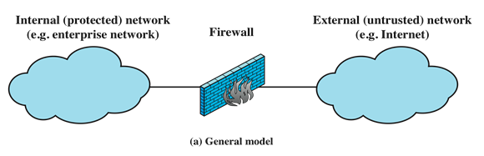
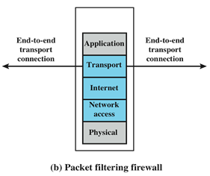
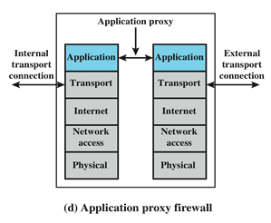
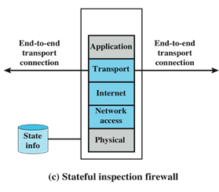
Types of Firewalls
Notes:
A firewall may act as a packet filter. It can operate as a positive filter, allowing to
pass only packets that meet specific criteria, or as a negative filter, rejecting any
packet that meets certain criteria. Depending on the type of firewall, it may examine
one or more protocol headers in each packet, the payload of each packet, or the
pattern generated by a sequence of packets. In this section, we look at the principal
types of firewalls.

Slide 23
Packet Filtering Firewall
applies rules to each incoming and outgoing IP packet
typically a list of rules based on matches in the IP or TCP header
forwards or discards the packet based on rules match
two default policies:
discard - prohibit unless expressly permitted
more conservative, controlled, visible to users
forward - permit unless expressly prohibited
easier to manage and use but less secure
Notes:
A packet filtering firewall applies a set of rules to each incoming and outgoing
IP packet and then forwards or discards the packet ( Figure 9.1b ). The firewall
is typically configured to filter packets going in both directions (from and to
the internal network). Filtering rules are based on information contained in a
network packet:
• Source IP address: The IP address of the system that originated the IP packet
(e.g., 192.178.1.1)
• Destination IP address: The IP address of the system the IP packet is trying to
reach (e.g., 192.168.1.2)
• Source and destination transport-level address: The transport-level (e.g., TCP
or UDP) port number, which defines applications such as SNMP or TELNET
• IP protocol field: Defines the transport protocol
• Interface: For a firewall with three or more ports, which interface of the firewall
the packet came from or which interface of the firewall the packet is destined for
The packet filter is typically set up as a list of rules based on matches to fields
in the IP or TCP header. If there is a match to one of the rules, that rule is invoked
to determine whether to forward or discard the packet. If there is no match to any
rule, then a default action is taken. Two default policies are possible:
• Default discard: That which is not expressly permitted is prohibited.
• Default forward: That which is not expressly prohibited is permitted.
The default discard policy is more conservative. Initially, everything is blocked,
and services must be added on a case-by-case basis. This policy is more visible to
users, who are more likely to see the firewall as a hindrance. However, this is the
policy likely to be preferred by businesses and government organizations. Further,
visibility to users diminishes as rules are created. The default forward policy increases
ease of use for end users but provides reduced security; the security administrator
must, in essence, react to each new security threat as it becomes known. This policy
may be used by generally more open organizations, such as universities.

Slide 24
Packet Filtering Firewall
filtering rules are based on information contained in a network packet
source IP address
destination IP address
source and destination transport-level address
IP protocol field
interface
Notes:
A packet filtering firewall applies a set of rules to each incoming and outgoing
IP packet and then forwards or discards the packet ( Figure 9.1b ). The firewall
is typically configured to filter packets going in both directions (from and to
the internal network). Filtering rules are based on information contained in a
network packet:
• Source IP address: The IP address of the system that originated the IP packet
(e.g., 192.178.1.1)
• Destination IP address: The IP address of the system the IP packet is trying to
reach (e.g., 192.168.1.2)
• Source and destination transport-level address: The transport-level (e.g., TCP
or UDP) port number, which defines applications such as SNMP or TELNET
• IP protocol field: Defines the transport protocol
• Interface: For a firewall with three or more ports, which interface of the firewall
the packet came from or which interface of the firewall the packet is destined for
The packet filter is typically set up as a list of rules based on matches to fields
in the IP or TCP header. If there is a match to one of the rules, that rule is invoked
to determine whether to forward or discard the packet. If there is no match to any
rule, then a default action is taken. Two default policies are possible:
• Default discard: That which is not expressly permitted is prohibited.
• Default forward: That which is not expressly prohibited is permitted.
The default discard policy is more conservative. Initially, everything is blocked,
and services must be added on a case-by-case basis. This policy is more visible to
users, who are more likely to see the firewall as a hindrance. However, this is the
policy likely to be preferred by businesses and government organizations. Further,
visibility to users diminishes as rules are created. The default forward policy increases
ease of use for end users but provides reduced security; the security administrator
must, in essence, react to each new security threat as it becomes known. This policy
may be used by generally more open organizations, such as universities.

Slide 25
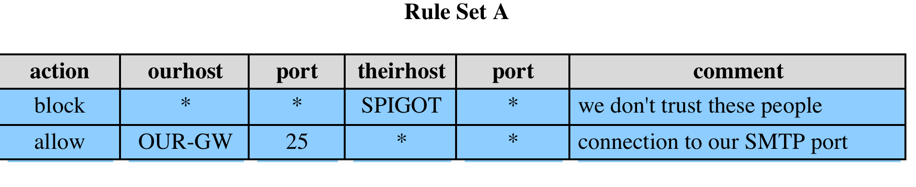
Packet Filter Rules Example
Notes:
Table 9.1 , from [BELL94], gives some examples of packet filtering rule sets. In
each set, the rules are applied top to bottom. The “*” in a field is a wildcard designator
that matches everything. We assume that the default discard policy is in force.
A. Inbound mail is allowed (port 25 is for SMTP incoming), but only to a gateway
host. However, packets from a particular external host, SPIGOT, are blocked
because that host has a history of sending massive files in e-mail messages.
B. This is an explicit statement of the default policy. All rule sets include this rule
implicitly as the last rule.
C. This rule set is intended to specify that any inside host can send mail to the
outside. A TCP packet with a destination port of 25 is routed to the SMTP
server on the destination machine. The problem with this rule is that the use of
port 25 for SMTP receipt is only a default; an outside machine could be configured
to have some other application linked to port 25. As this rule is written,
an attacker could gain access to internal machines by sending packets with a
TCP source port number of 25.
D. This rule set achieves the intended result that was not achieved in C. The rules
take advantage of a feature of TCP connections. Once a connection is set up,
the ACK flag of a TCP segment is set to acknowledge segments sent from the
other side. Thus, this rule set states that it allows IP packets where the source
IP address is one of a list of designated internal hosts and the destination TCP
port number is 25. It also allows incoming packets with a source port number
of 25 that include the ACK flag in the TCP segment. Note that we explicitly
designate source and destination systems to define these rules explicitly.
E. This rule set is one approach to handling FTP connections. With FTP, two TCP
connections are used: a control connection to set up the file transfer and a data
connection for the actual file transfer. The data connection uses a different port
number that is dynamically assigned for the transfer. Most servers, and hence
most attack targets, use low-numbered ports; most outgoing calls tend to use a
higher-numbered port, typically above 1023. Thus, this rule set allows
• Packets that originate internally
• Reply packets to a connection initiated by an internal machine
• Packets destined for a high-numbered port on an internal machine
Rule set E points out the difficulty in dealing with applications at the packet
filtering level. Another way to deal with FTP and similar applications is either
stateful packet filters or an application-level gateway, both described subsequently
in this section.

Slide 26
Stateful Firewall Connection State
Notes:
A stateful inspection packet firewall tightens up the rules for TCP traffic by
creating a directory of outbound TCP connections, as shown in Table 9.2 . There is
an entry for each currently established connection. The packet filter will now allow
incoming traffic to high-numbered ports only for those packets that fit the profile of
one of the entries in this directory.

Slide 27
Stateful Inspection Firewall
tightens rules for TCP traffic by creating a directory of outbound TCP connections
there is an entry for each currently established connection
packet filter allows incoming traffic to high numbered ports
only for those packets that fit the profile of one of the entries
reviews packet information but also records information about TCP connections
keeps track of TCP sequence numbers to prevent attacks that depend on the sequence number
inspects data for protocols like FTP, IM and SIPS commands
Notes:
A traditional packet filter makes filtering decisions on an individual packet basis
and does not take into consideration any higher-layer context. To understand what
is meant by context and why a traditional packet filter is limited with regard to context,
a little background is needed. Most standardized applications that run on top
of TCP follow a client/server model. For example, for the Simple Mail Transfer
Protocol (SMTP), e-mail is transmitted from a client system to a server system.
The client system generates new e-mail messages, typically from user input. The
server system accepts incoming e-mail messages and places them in the appropriate
user mailboxes. SMTP operates by setting up a TCP connection between client
and server, in which the TCP server port number, which identifies the SMTP server
application, is 25. The TCP port number for the SMTP client is a number between
1024 and 65535 that is generated by the SMTP client.
In general, when an application that uses TCP creates a session with a remote
host, it creates a TCP connection in which the TCP port number for the remote
(server) application is a number less than 1024 and the TCP port number for the
local (client) application is a number between 1024 and 65535. The numbers less
than 1024 are the “well-known” port numbers and are assigned permanently to
particular applications (e.g., 25 for server SMTP). The numbers between 1024 and
65535 are generated dynamically and have temporary significance only for the
lifetime of a TCP connection.
A simple packet filtering firewall must permit inbound network traffic on all
these high-numbered ports for TCP-based traffic to occur. This creates a vulnerability
that can be exploited by unauthorized users.
A stateful packet inspection firewall reviews the same packet information
as a packet filtering firewall, but also records information about TCP connections
( Figure 9.1c ). Some stateful firewalls also keep track of TCP sequence numbers
to prevent attacks that depend on the sequence number, such as session hijacking.
Some even inspect limited amounts of application data for some well-known
protocols like FTP, IM, and SIPS commands, in order to identify and track related
connections.

Slide 28
Application-Level Gateway
also called an application proxy
acts as a relay of application-level traffic
user contacts gateway using a TCP/IP appl.
user is authenticated
gateway contacts application on remote host and relays TCP segments between server and user
must have proxy code for each application
may restrict application features supported
tend to be more secure than packet filters
disadvantage is the additional processing overhead on each connection
Notes:
An application-level gateway, also called an application proxy , acts as a relay of
application-level traffic ( Figure 9.1d ). The user contacts the gateway using a TCP/
IP application, such as Telnet or FTP, and the gateway asks the user for the name
of the remote host to be accessed. When the user responds and provides a valid
user ID and authentication information, the gateway contacts the application on
the remote host and relays TCP segments containing the application data between
the two endpoints. If the gateway does not implement the proxy code for a specific
application, the service is not supported and cannot be forwarded across the firewall.
Further, the gateway can be configured to support only specific features of an
application that the network administrator considers acceptable while denying all
other features.
Application-level gateways tend to be more secure than packet filters. Rather
than trying to deal with the numerous possible combinations that are to be allowed
and forbidden at the TCP and IP level, the application-level gateway need only
scrutinize a few allowable applications. In addition, it is easy to log and audit all
incoming traffic at the application level.
A prime disadvantage of this type of gateway is the additional processing
overhead on each connection. In effect, there are two spliced connections between
the end users, with the gateway at the splice point, and the gateway must examine
and forward all traffic in both directions.

Slide 29
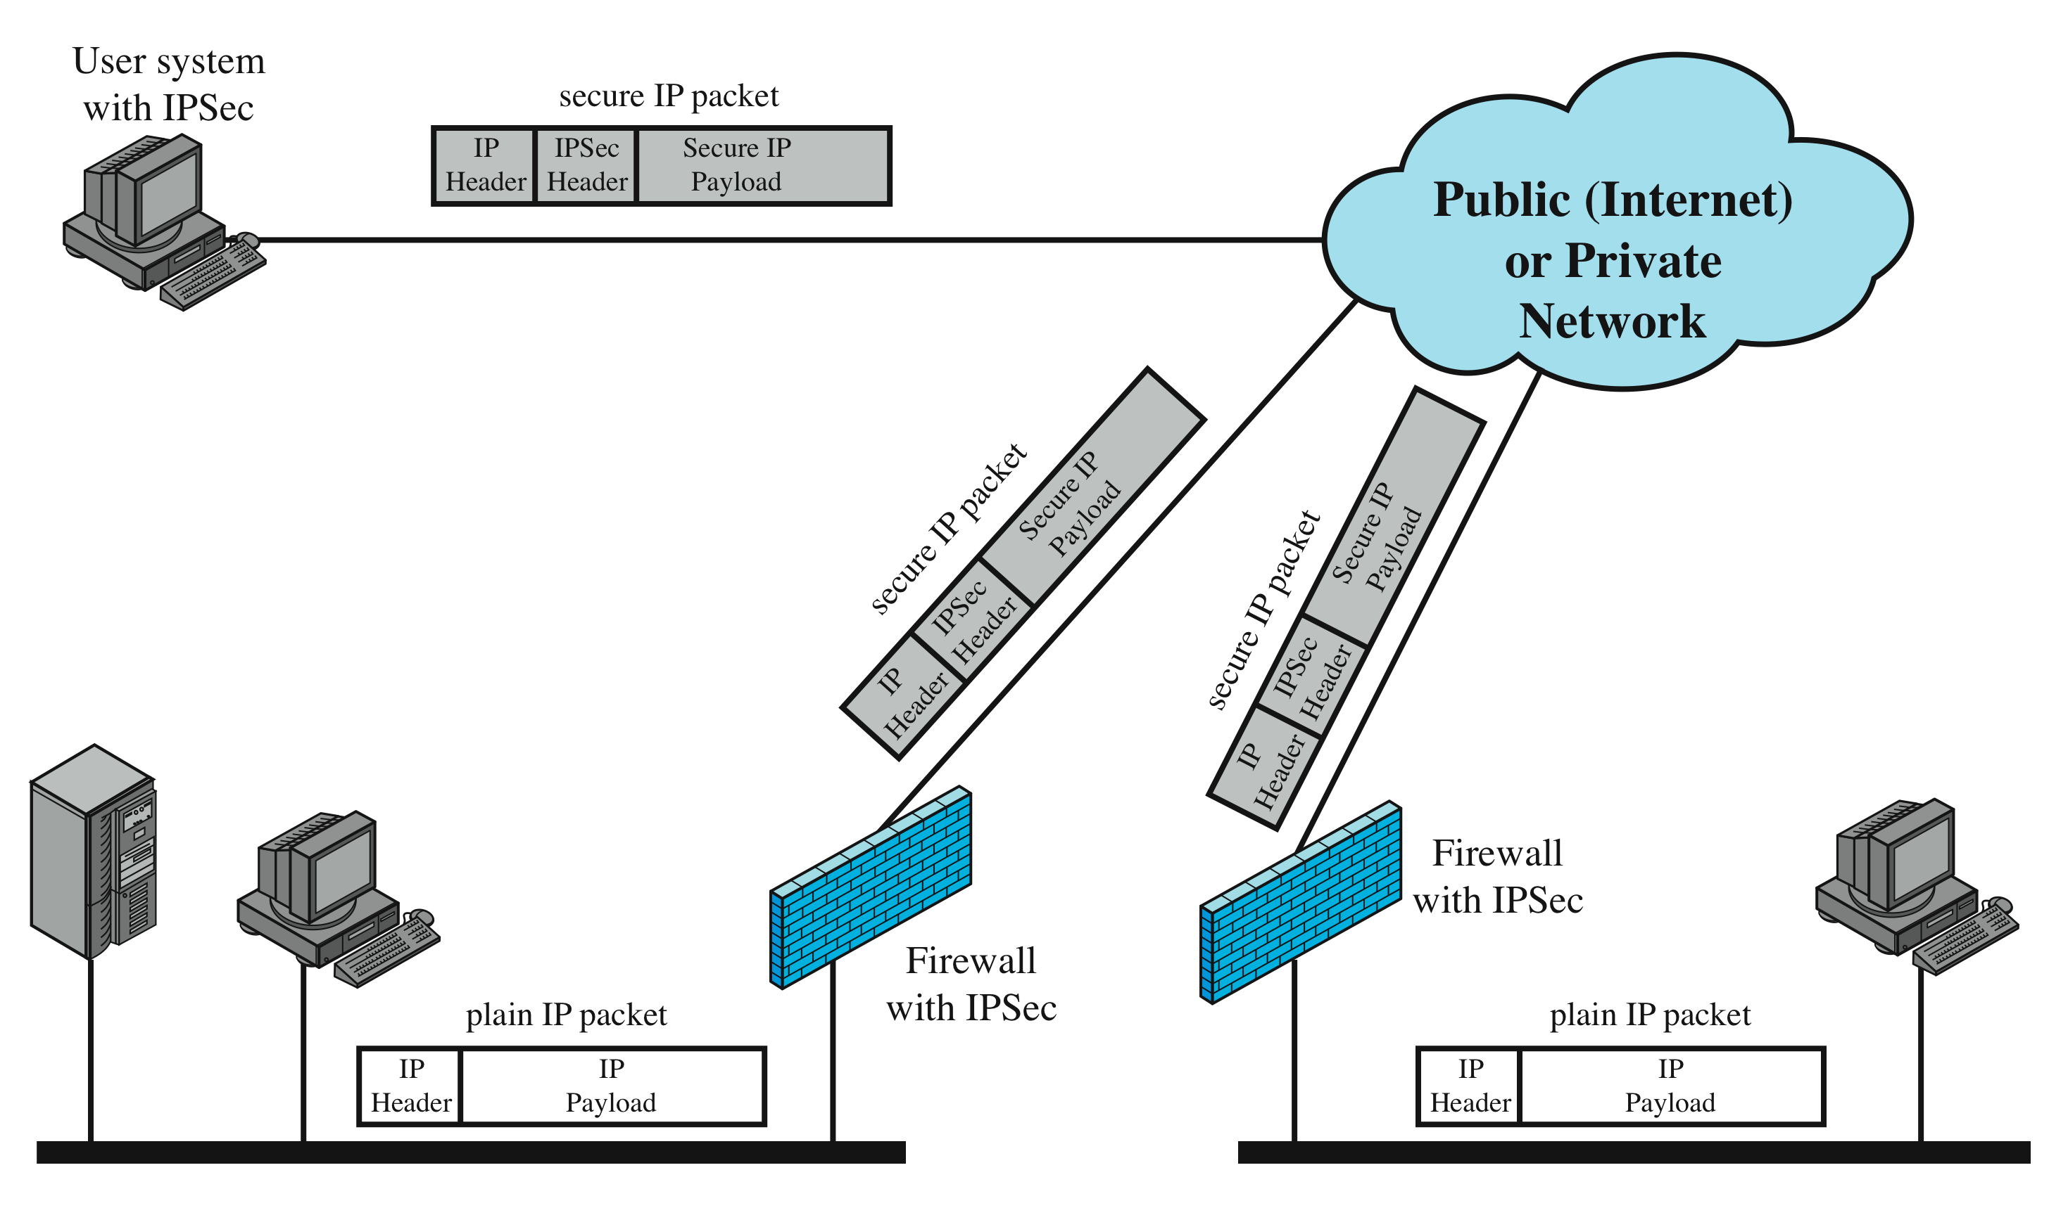
Virtual Private Networks (VPNs)
Notes:
In today’s distributed computing environment, the virtual private network (VPN)
offers an attractive solution to network managers. In essence, a VPN consists of
a set of computers that interconnect by means of a relatively unsecure network
and that make use of encryption and special protocols to provide security. At each
corporate site, workstations, servers, and databases are linked by one or more local
area networks (LANs). The Internet or some other public network can be used to
interconnect sites, providing a cost savings over the use of a private network and
offloading the wide area network management task to the public network provider.
That same public network provides an access path for telecommuters and other
mobile employees to log on to corporate systems from remote sites.
But the manager faces a fundamental requirement: security. Use of a public
network exposes corporate traffic to eavesdropping and provides an entry point for
unauthorized users. To counter this problem, a VPN is needed. In essence, a VPN
uses encryption and authentication in the lower protocol layers to provide a secure
connection through an otherwise insecure network, typically the Internet. VPNs are
generally cheaper than real private networks using private lines but rely on having
the same encryption and authentication system at both ends. The encryption may
be performed by firewall software or possibly by routers. The most common protocol
mechanism used for this purpose is at the IP level and is known as IPSec.
Figure 9.3 is a typical scenario of IPSec usage. 1 An organization maintains
LANs at dispersed locations. Nonsecure IP traffic is conducted on each LAN. For
traffic off site, through some sort of private or public WAN, IPSec protocols are
used. These protocols operate in networking devices, such as a router or firewall,
that connect each LAN to the outside world. The IPSec networking device will
typically encrypt and compress all traffic going into the WAN and decrypt and
uncompress traffic coming from the WAN; authentication may also be provided.
These operations are transparent to workstations and servers on the LAN. Secure
transmission is also possible with individual users who dial into the WAN. Such
user workstations must implement the IPSec protocols to provide security. They
must also implement high levels of host security, as they are directly connected to

Slide 30

Summary
intruders
masquerader
misfeasor
clandestine user
intruder behavior patterns
hacker
criminal enterprise
internal threat
security intrusion/intrusion detection
intrusion detection systems
host-based
network-based
sensors, analyzers, user interface
host-based
anomaly detection
signature detection
audit records
distributed host-based intrusion detection
network-based
sensors: inline/passive
distributed adaptive intrusion detection
intrusion detection exchange format
honeypot
SNORT
Notes:
Chapter 8 summary.

